Slide 1


Deep Learning for Natural Language Processing
DLNLP 5: Feed Forward Neural Networks
Mihai Surdeanu and Marco A. Valenzuela-Escárcega

Slide 2
Overview
Architecture of feed-forward neural networks (FFNNs)
Learning algorithm for FFNNs
Equations of back-propagation

Slide 3
Architecture

Slide 4
Drawbacks of logistic regression
Linear classifier
  Feed-forward neural networks (FFNNs) can approximate any function!

Slide 5
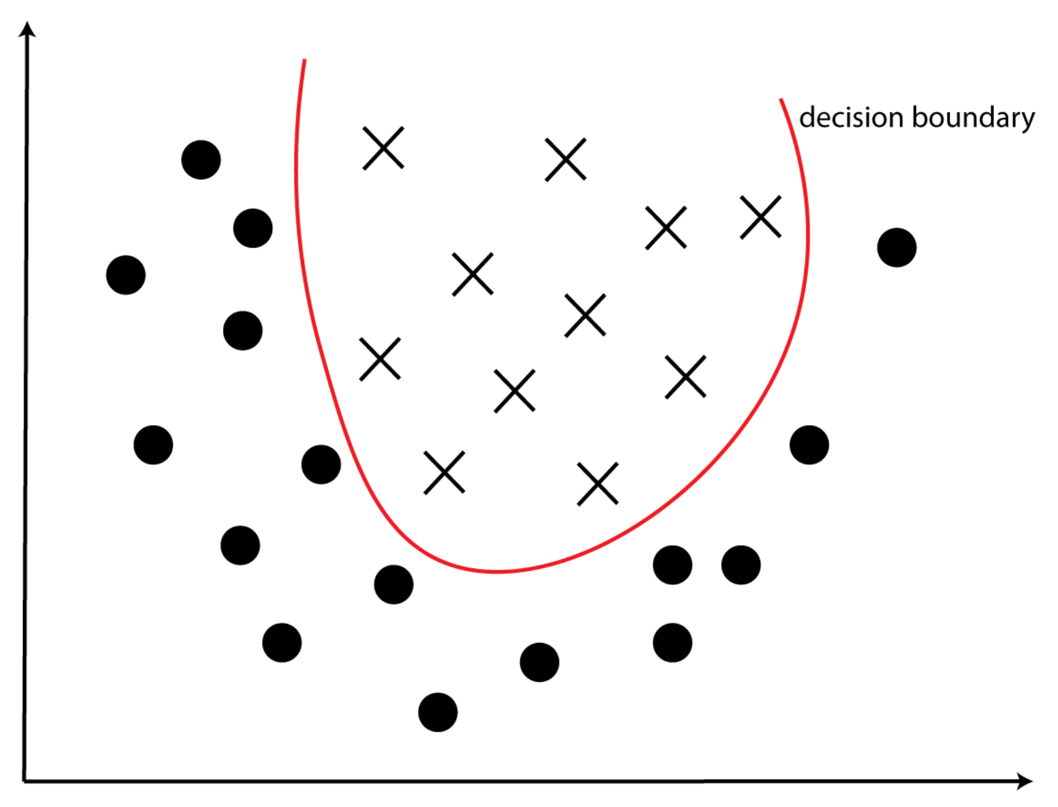
Example of non-linear classifier

Slide 6
Drawbacks of logistic regression
Linear classifier
  Feed-forward neural networks (FFNNs) can approximate any function!
Hand-crafted features
  We will address this limitation when we discuss word embeddings

Slide 7
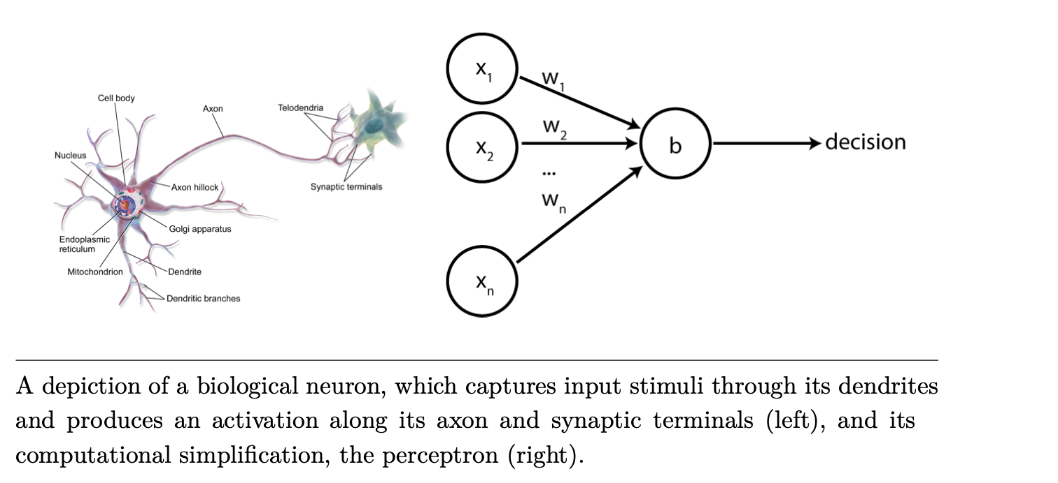
Reminder: perceptron

Slide 8
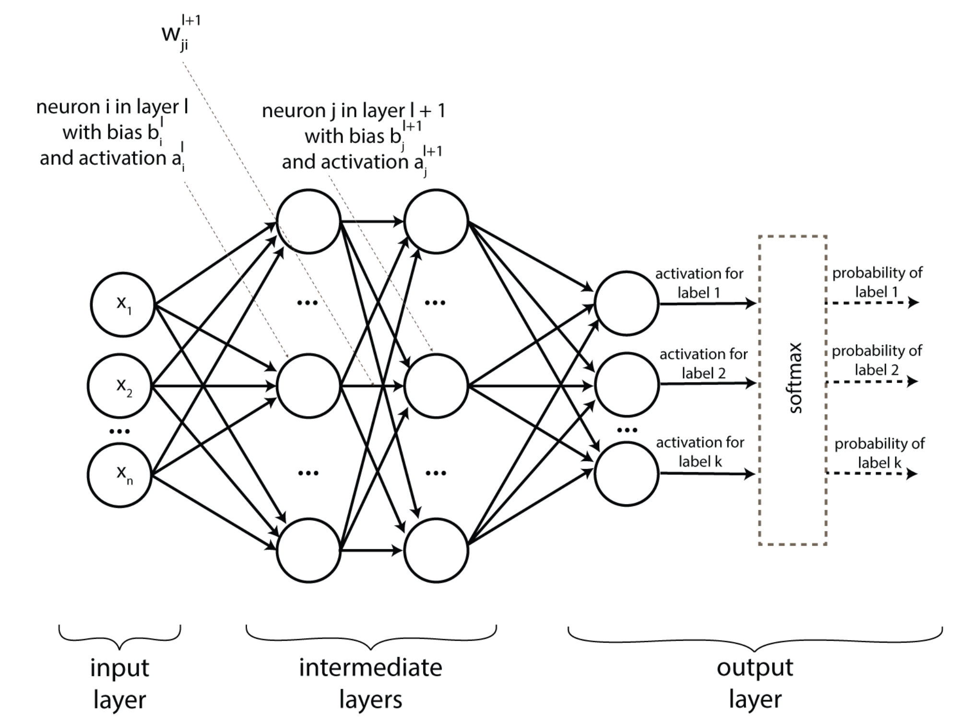
FFNN architecture

Slide 9
Input layer

Slide 10
Input layer
Each input vector x describes one data point
    Collection of explicit features (what we have seen so far), or
    A numerical representation of the input (based on word embeddings, next lecture)

Slide 11
Intermediate layers

Slide 12
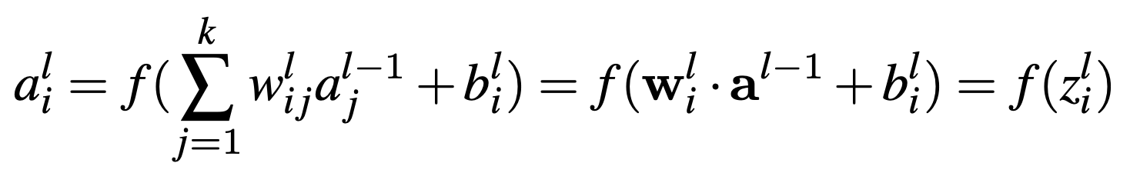
Intermediate layers

Slide 13
Intermediate layers
Output (or activation) of this neuron

Slide 14
Intermediate layers
Inputs to this neuron, i.e., activations of neurons in the previous layer

Slide 15
Intermediate layers
Weights of the edges connecting layer l - 1 with layer l

Slide 16
Intermediate layers
Nonlinear function such as sigmoid (or tanh, ReLU)

Slide 17
Output layer

Slide 18
Output layer
One neuron per class to be learned
  For example, we need 3 neurons to learn a review classifier that outputs: positive, neutral, negative.
Output scores may be converted to a probability distribution using the softmax function
  Softmax: takes a bunch of values and converts them to values in the [0, 1] interval such that they sum up to 1.

Slide 19
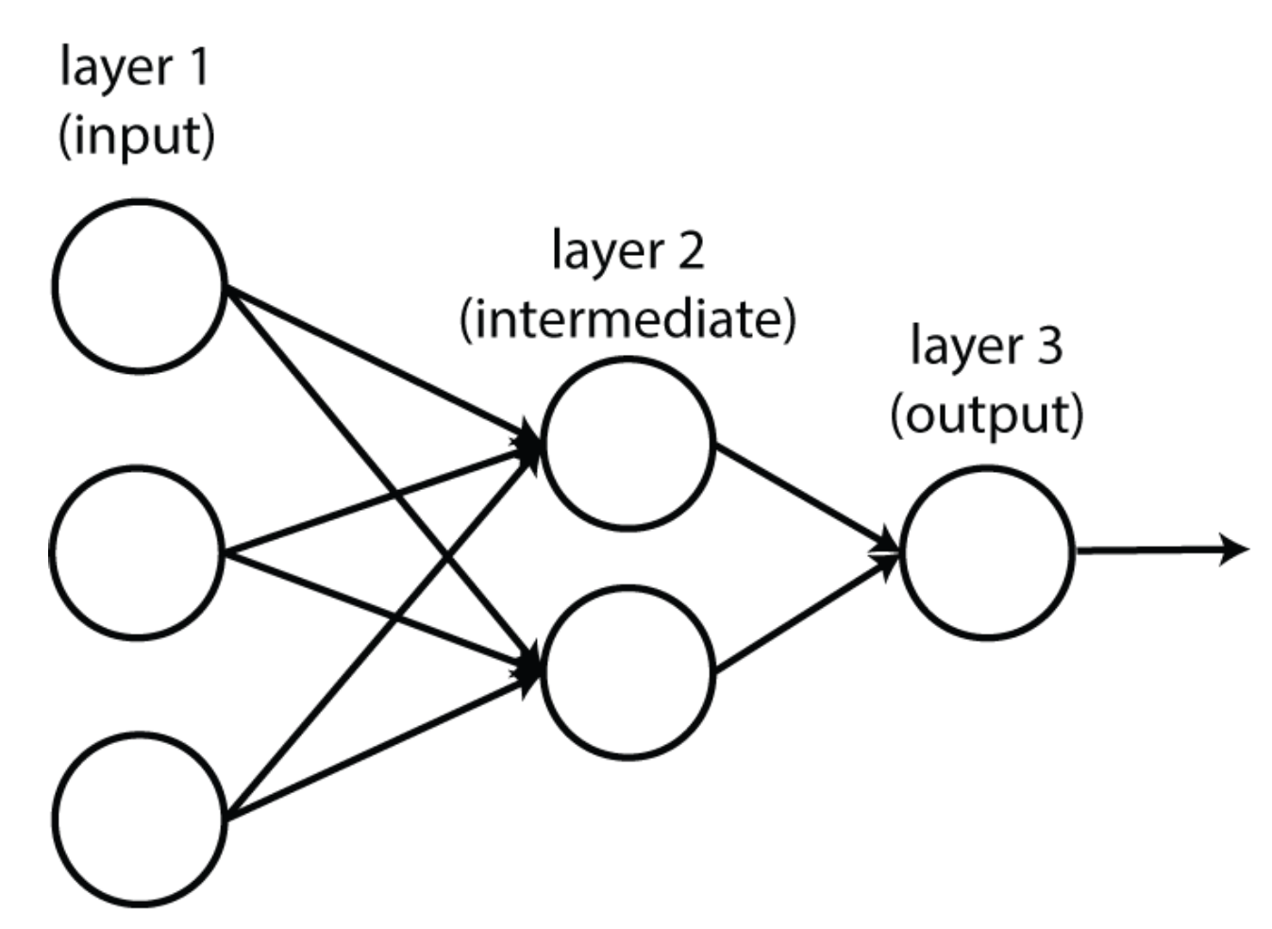
FFNNs can be linear functions
(when f is a pass-through function: f(x) = x)

Slide 20
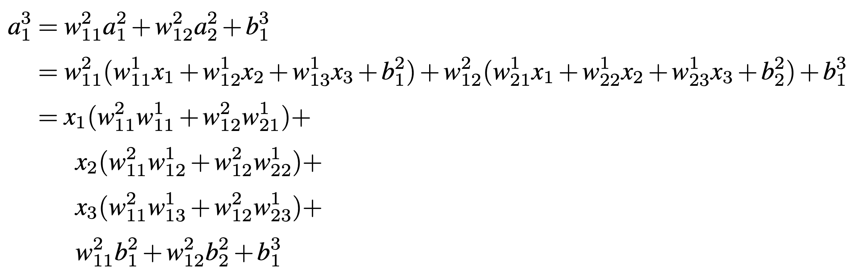
FFNNs can be linear functions
(when f is a pass-through function: f(x) = x)

Slide 21
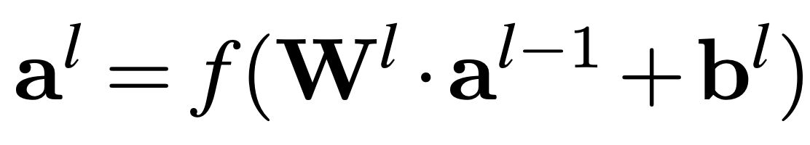
Tensor notation
Each layer can be described by this simpler equation that relies on matrices and vectors:
Lower case, bold font = vector
Upper case, bold font = matrix

Slide 22
Tensor notation
Each layer can be described by this simpler equation that relies on matrices and vectors:
All activations in layer l
All activations in layer l - 1

Slide 23
Tensor notation
Each layer can be described by this simpler equation that relies on matrices and vectors:
All weights connecting layer l – 1 with layer l

Slide 24
FFNNs are generalizations of the perceptron and LR
Perceptron
  No intermediate layers
  f(x) = x
  Single output neuron; no softmax
Binary logistic regression
  No intermediate layers
  f(x) = sigmoid(x)
  Single output neuron; no softmax
Multiclass logistic regression
  No intermediate layers
  f(x) = x
  Multiple output neurons with softmax

Slide 25
Learning algorithm

Slide 26
Learning algorithm intuition
Gradient descent, exactly the same as the one used for logistic regression!
“Knob turning”
  ”knob” = weight of an edge
  If a neuron increases the probability of an incorrect prediction, its knobs will be turned down.
  If a neuron increases the probability of a correct prediction, its knobs will be turned up.

Slide 35
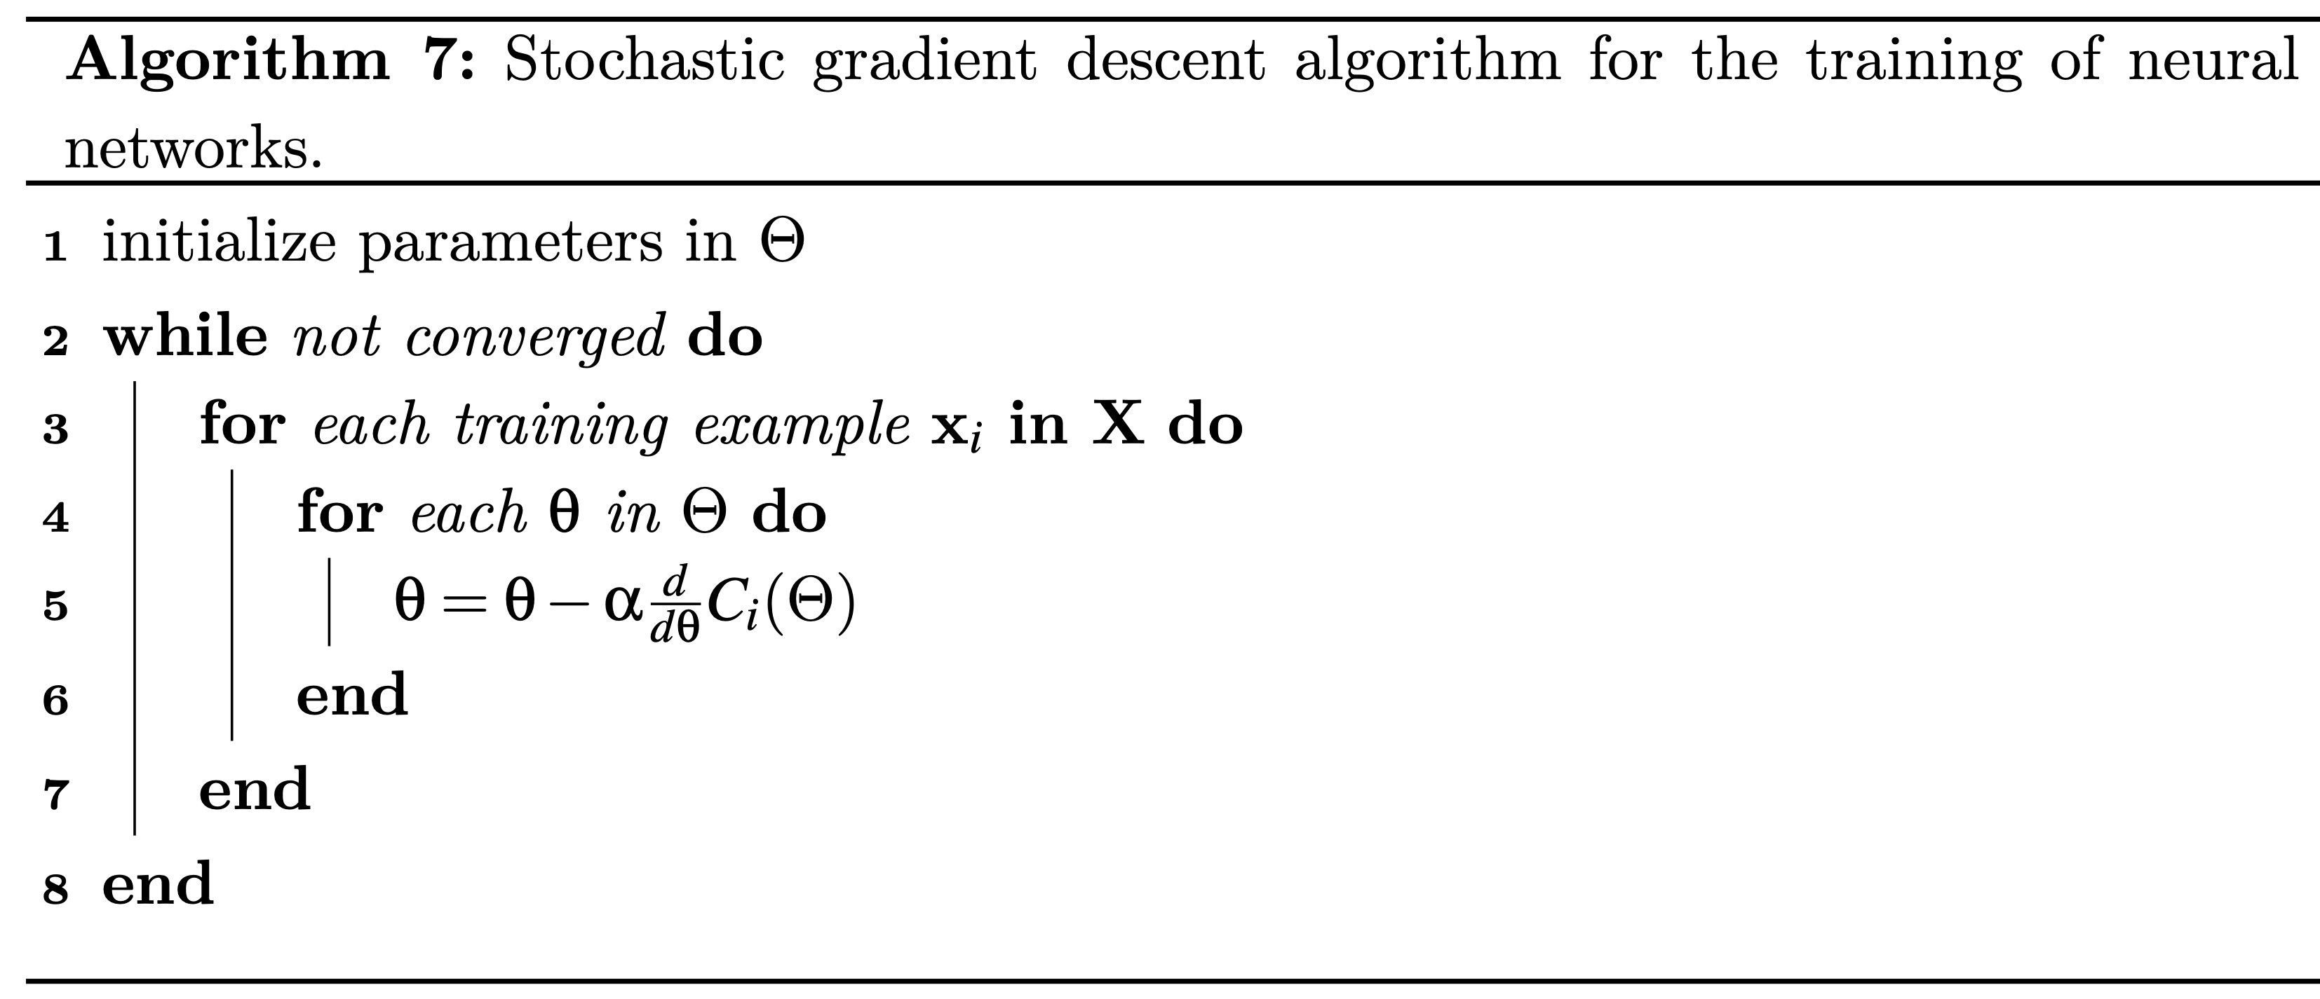

Slide 36
Collection of all weights and biases in the network

Slide 37
One training example

Slide 38
Partial derivative of the cost function C for each parameter (weight or bias) in the network

Slide 39
Learning rate, which is a hyper parameter

Slide 40
But how do we compute these partial derivatives, especially for edges that are not directly connected to the output neurons?
Back-propagation to the rescue!

Slide 41
Equations of back-propagation
(only required for grad students!)

Slide 42
Back-propagation intuition
Recursively propagate neuron contributions to the output errors from the last layer back to the first

Slide 43
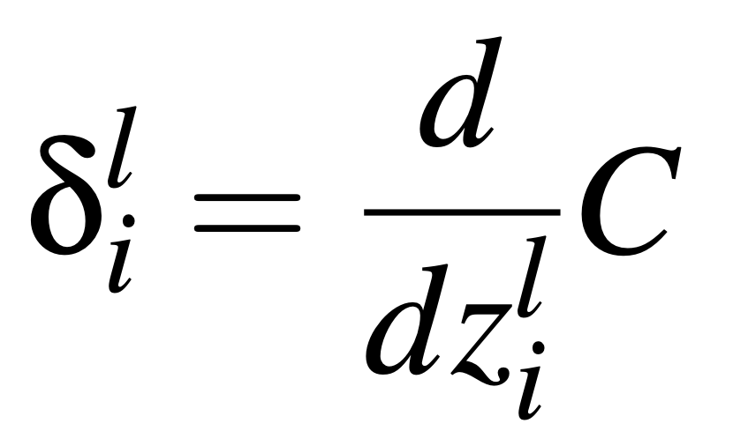
Notations
Simplify C_{i}(Θ) as C
Error of neuron i in layer l:
  This is the key “knob”
  The higher the error, the larger the parameter adjustments for this neuron
L: index of the final network layer

Slide 44
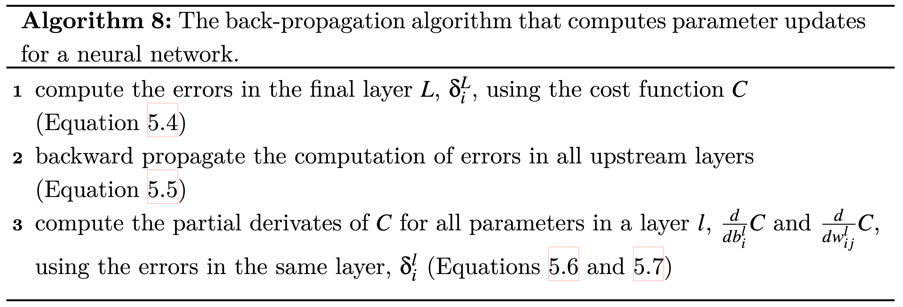
Four equations for back-propagation

Slide 45
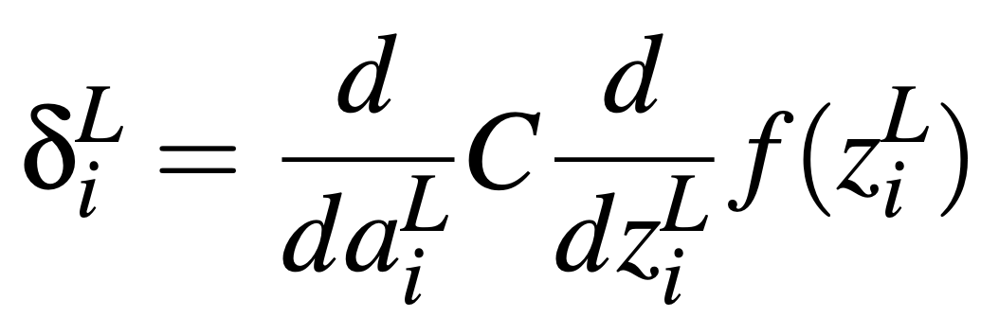
Backprop equation 1:
Error of a neuron in the final layer

Slide 46
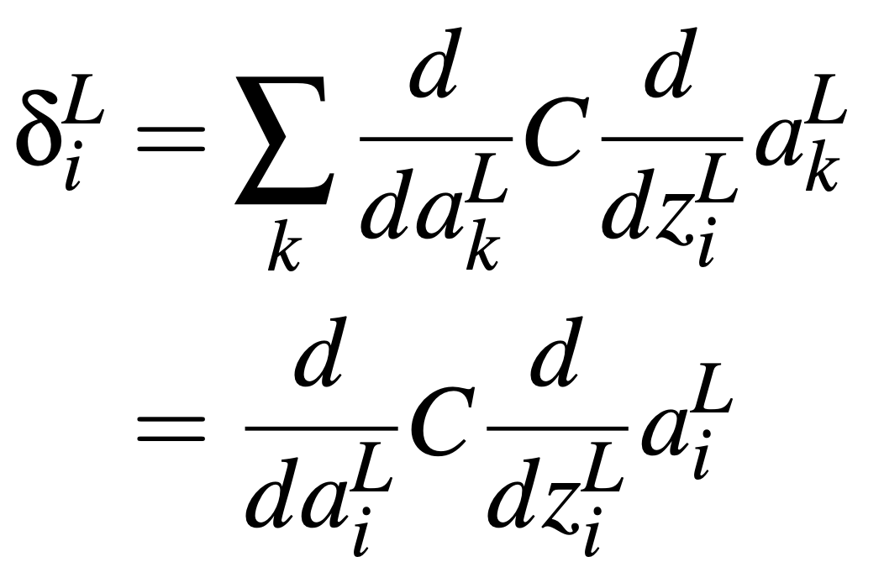
Proof of backprop equation 1

Slide 47
Proof of backprop equation 1
Must loop over all k neurons in the last layer. However, neuron i impacts only its own activation, so we can ignore the others.

Slide 48
Proof of backprop equation 1
Chain rule!

Slide 49
Note
Proofs of the 4 equations of back-propagation are required just for grad students!

Slide 50
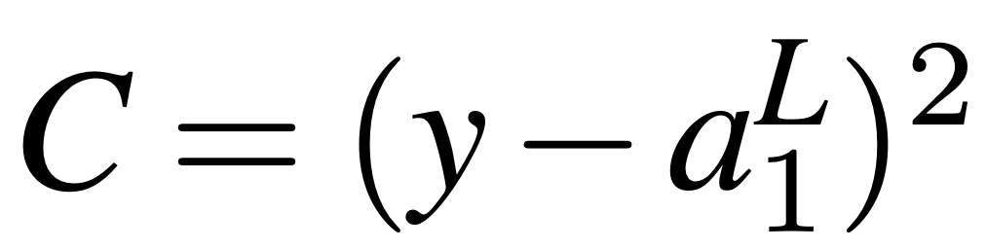
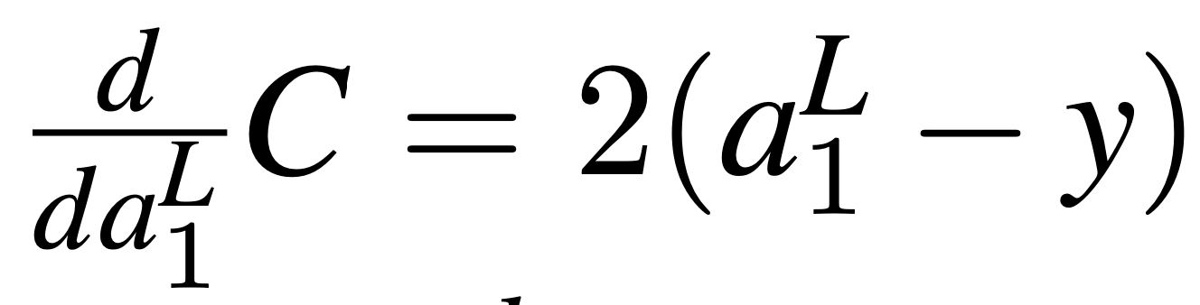
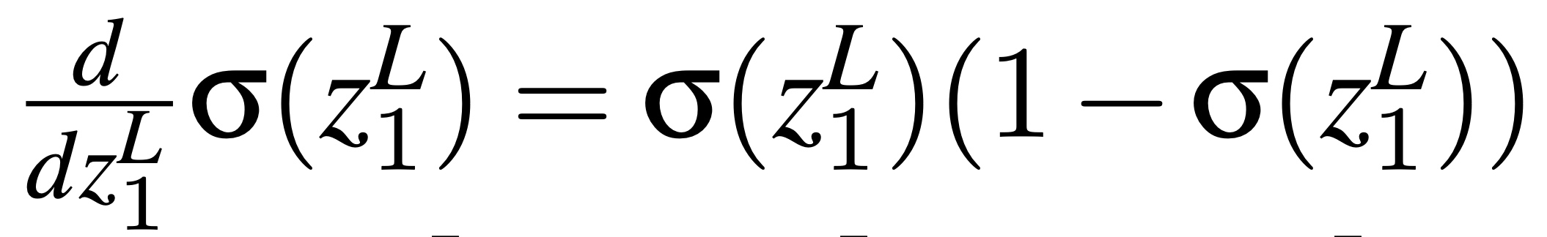
Example of equation 1:
Binary logistic regression with MSE cost
MSE cost:
Derivatives we need:
Then:
A good “knob”

Slide 51
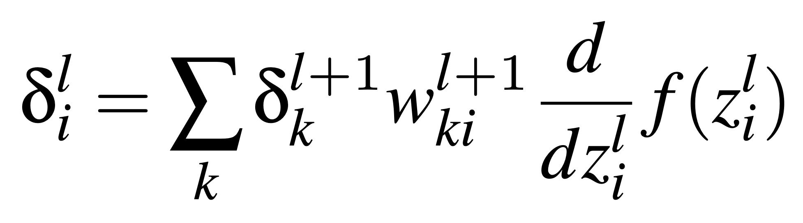
Backprop equation 2:
Error of a neuron in an intermediate layer
Recursive back-propagation

Slide 52
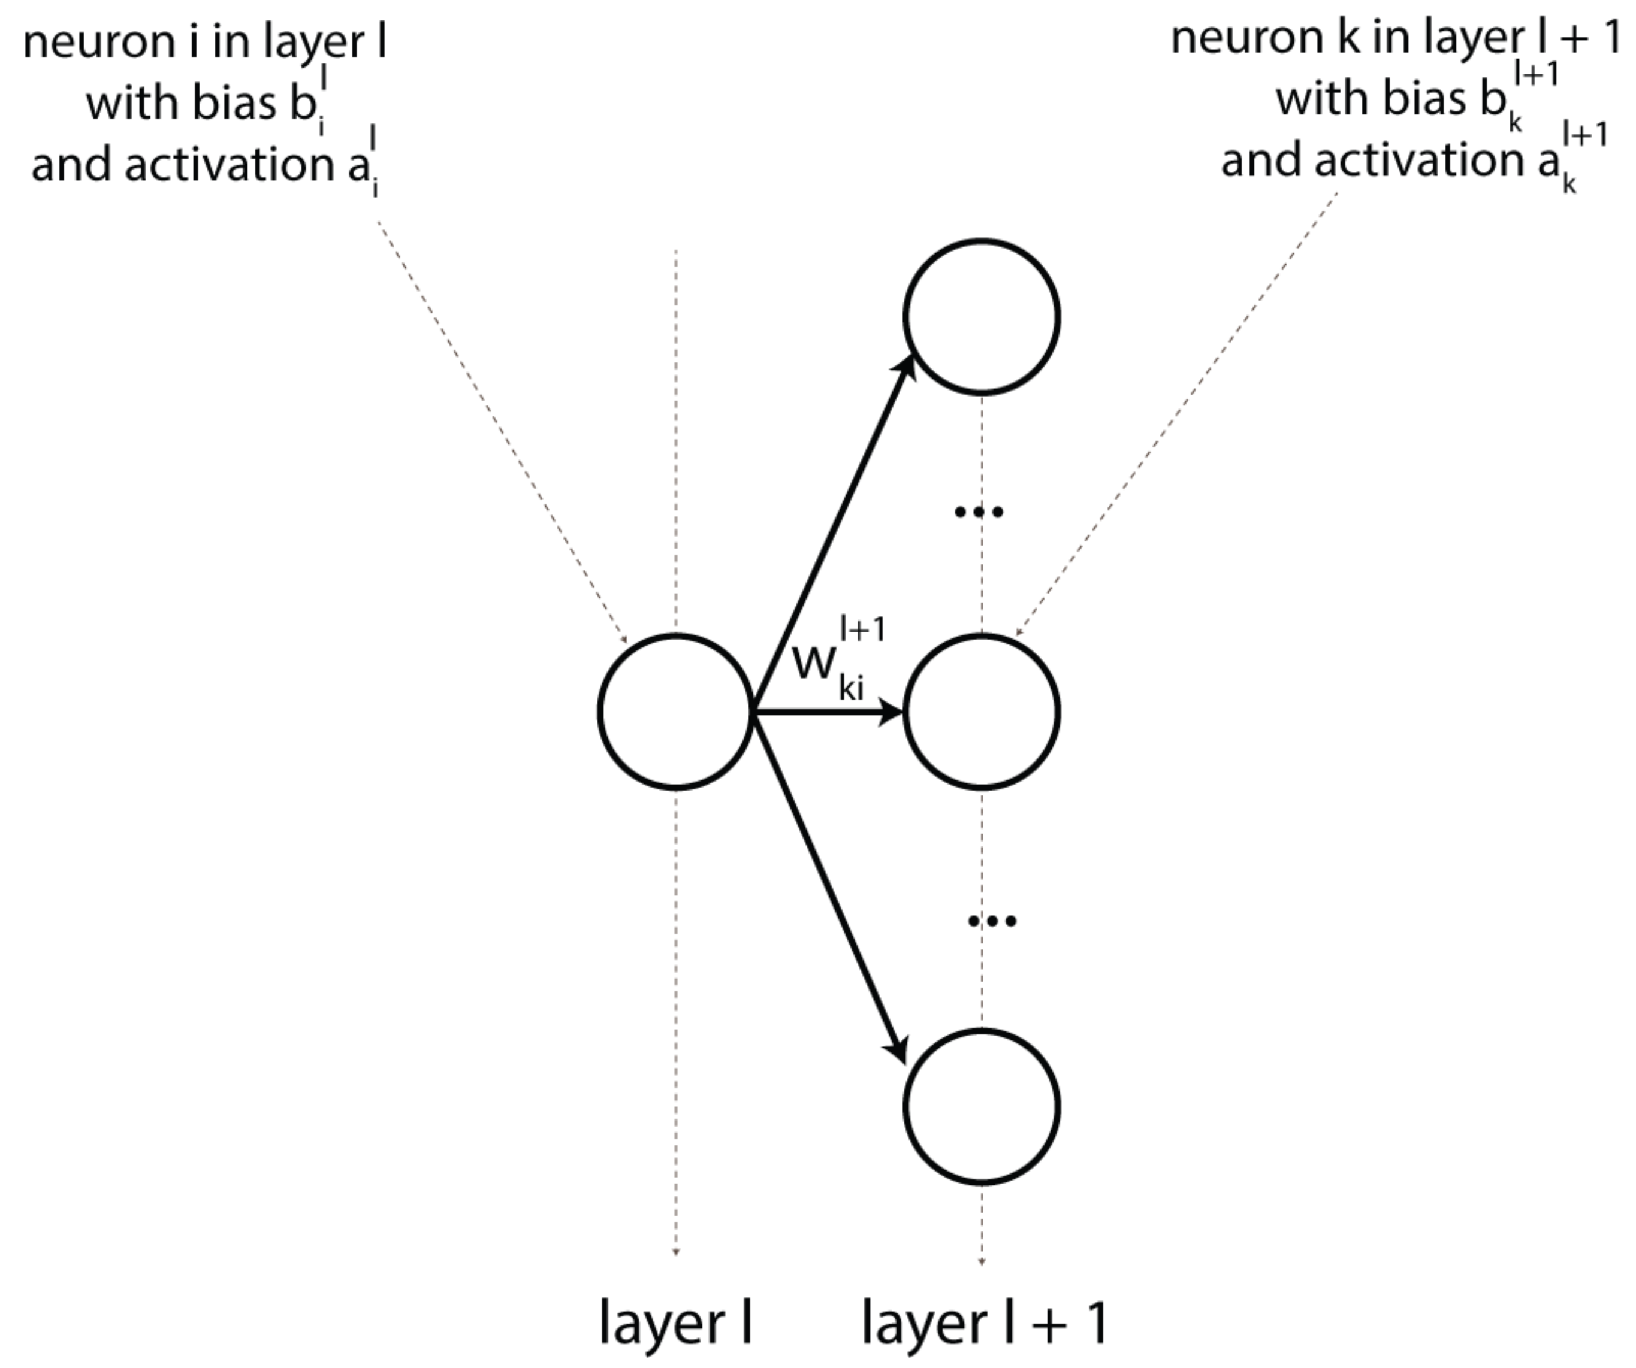
Visual helper for backprop equation 2

Slide 53
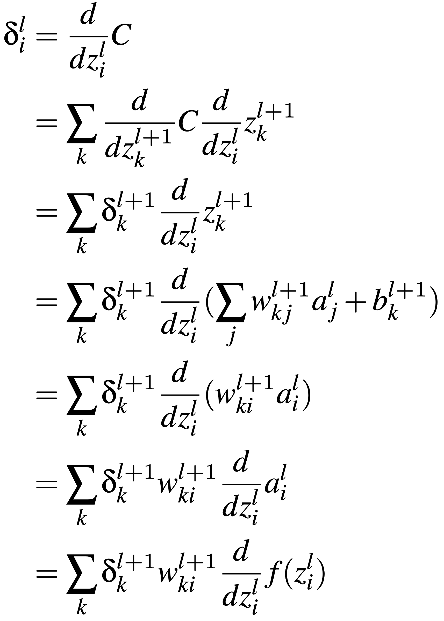
Proof of backprop equation 2

Slide 54
Proof of backprop equation 2
Chain rule again

Slide 55
Proof of backprop equation 2
Connections from neuron j to k can be ignored for i != j

Slide 56
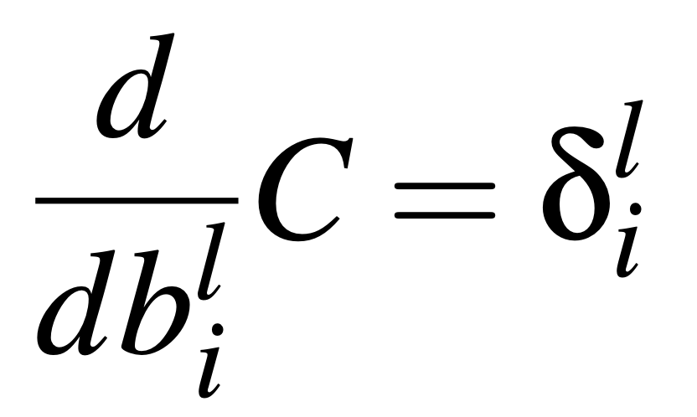
Backprop equation 3:
Update for any bias term

Slide 57
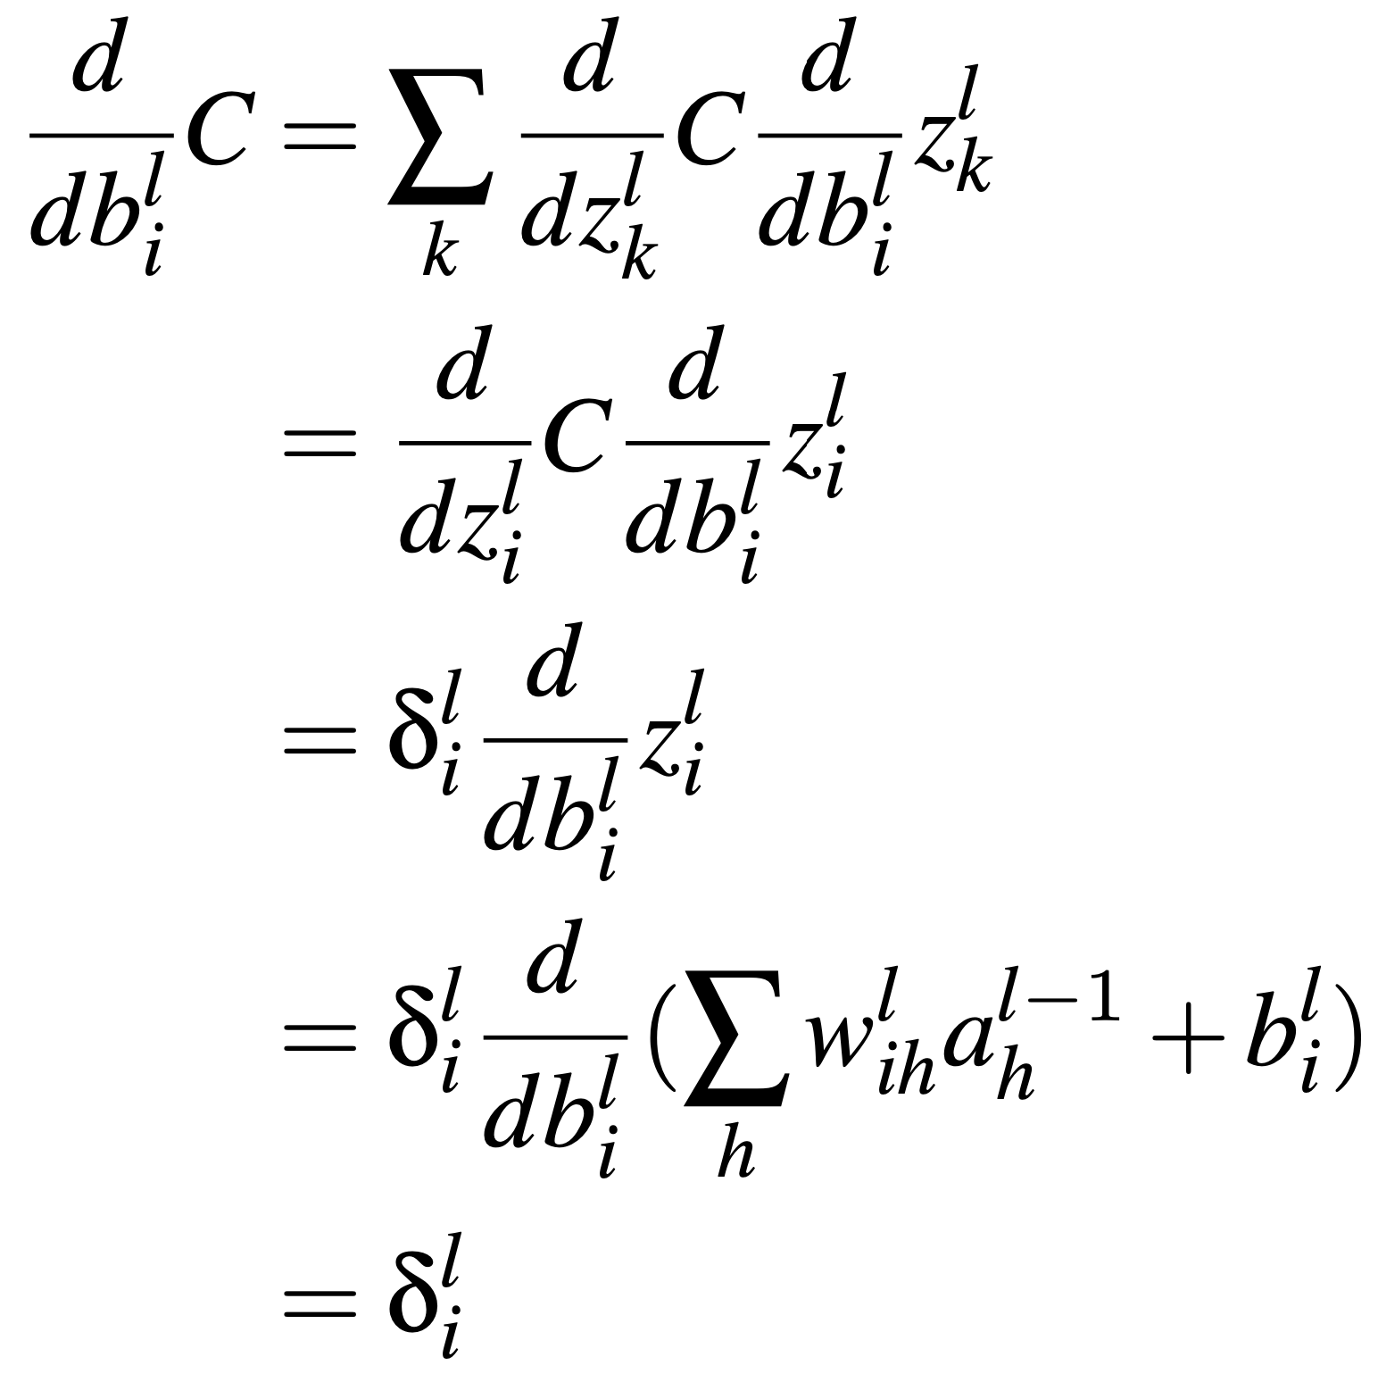
Proof for backprop equation 3

Slide 58
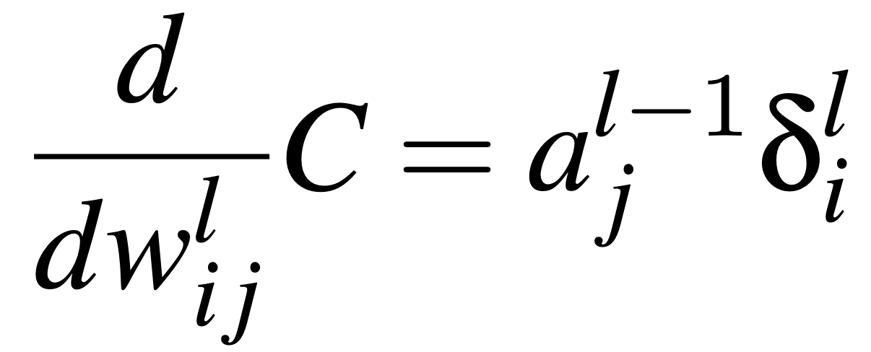
Backprop equation 4

Slide 59
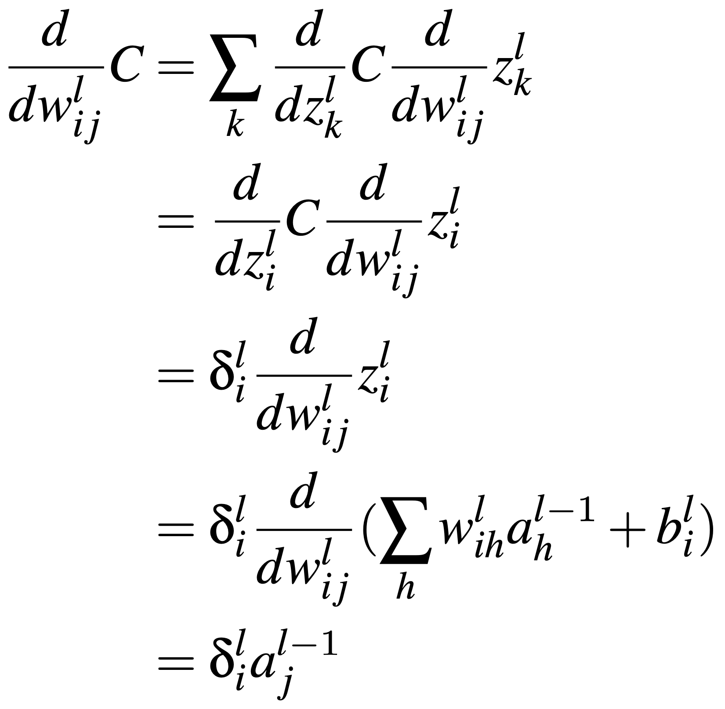
Proof of backprop equation 4

Slide 60
The 4 equations of back-propagation

Slide 61
Drawbacks of feed-forward neural networks
Back-propagation is slow, especially for networks with >> parameters.
  The brain probably does not learn using back-propagation (e.g., if it did, our vision would regularly black out during updates)
FFNNs are very powerful classifiers (i.e., can learn any function), but this can lead to overfitting (i.e., “hallucinating” a classifier)
So far, we discussed FFNNs that rely on hand-crafted features

Slide 62
Take away
Architecture of feed-forward neural networks (FFNNs)
Learning algorithm for FFNNs
Equations of back-propagation

